Slide 1

Git Basics

Slide 2
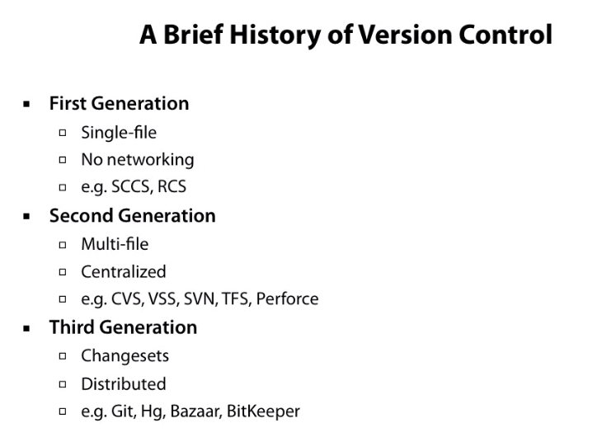
Introduction

Slide 3
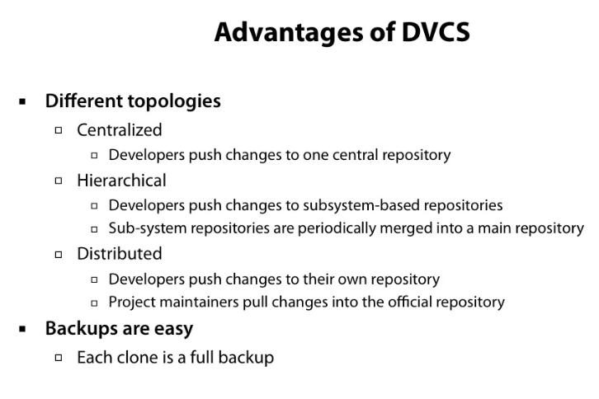
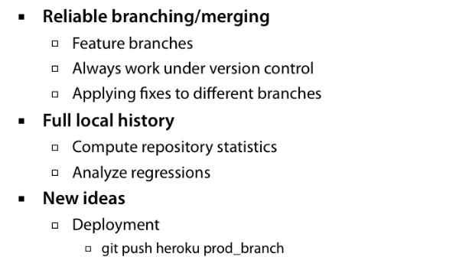
Introduction
Notes:
Devps push

Slide 4
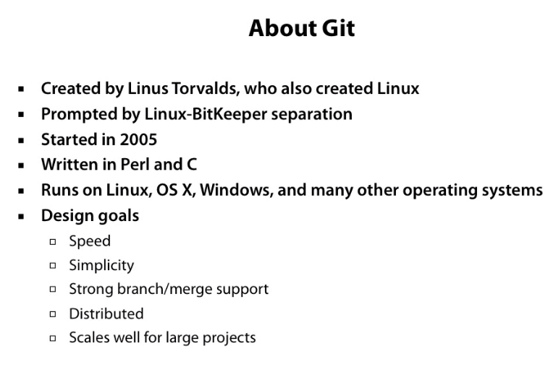
Introduction
Notes:
Devps push

Slide 5
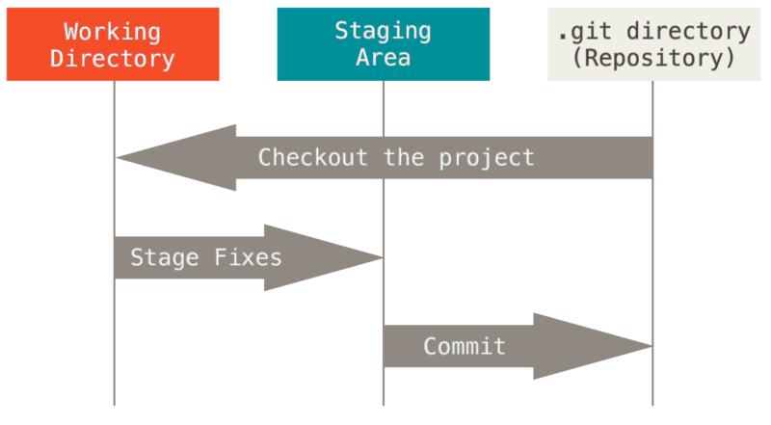
Git Project

Slide 6
Git Project
The Git directory is where Git stores the metadata and object database for your project. This is the most important part of Git, and it is what is copied when you clone a repository from another computer.
The working tree is a single checkout of one version of the project. These files are pulled out of the compressed database in the Git directory and placed on disk for you to use or modify.
The staging area is a file, generally contained in your Git directory, that stores information about what will go into your next commit. Its technical name in Git parlance is the “index”, but the phrase “staging area” works just as well.

Slide 7
Terminologies
Local Repository
Every VCS tool provides a private workplace as a working copy. Developers make changes in their private workplace and after commit, these changes become a part of the repository.
Commits
Commit holds the current state of the repository. You can consider a commit object as a node of the linked list. Every commit object has a pointer to the parent commit object.
Branches
Branches are used to create another line of development. Usually, a branch is created to work on a new feature. Once the feature is completed, it is merged back with the master branch and we delete the branch.
Tags
Tag assigns a meaningful name with a specific version in the repository.
Clone
Clone operation creates the local instance of the repository.
Pull
Pull operation copies the changes from a remote repository instance to a local one.
Push
Push operation copies changes from a local repository instance to a remote one.
HEAD
HEAD is a pointer, which always points to the latest commit in the branch. Whenever you make a commit, HEAD is updated with the latest commit

Slide 8
Terminologies
Blobs
Blob stands for Binary Large Object. Each version of a file is represented by blob. A blob holds the file data but doesn’t contain any metadata about the file
Trees
Tree is an object, which represents a directory. It holds blobs as well as other sub-directories.

Slide 9
Git Workflow
General workflow is as follows:
You clone the Git repository as a working copy.
You modify the working copy by adding/editing files.
If necessary, you also update the working copy by taking other developer's changes.
You review the changes before commit.
You commit changes. If everything is fine, then you push the changes to the repository.
After committing, if you realize something is wrong, then you correct the last commit and push the changes to the repository.

Slide 10
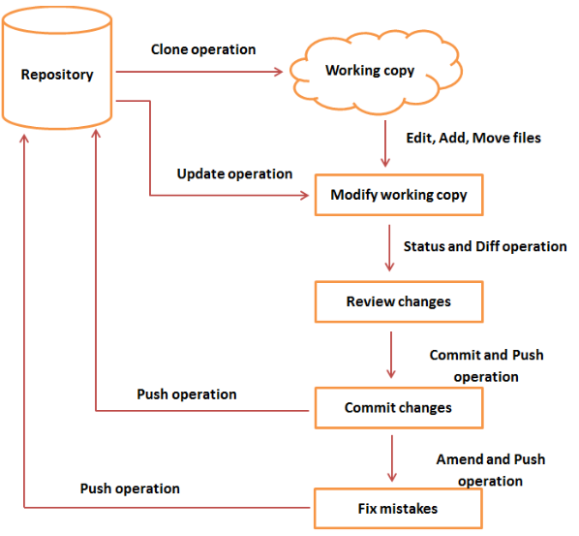
Git Workflow

Slide 11
Using Git
The first thing you should do when you install Git is to set your user name and email address. This is important because every Git commit uses this information, and it’s immutably baked into the commits you start creating:
$ git config --global user.name “samplearjun"
$ git config --global user.email johndoe@example.com

Slide 12
Using Git
$ git clone https://github.com/samplearjun/java1
$ cd java1
$ git status
git status command will show files present in the staging area. If new files are present and not added, this will be prompted
$ git add test.java
$ git status
$ git commit -m "New test file added”
$ git pull origin master
$ git push origin master

Slide 13
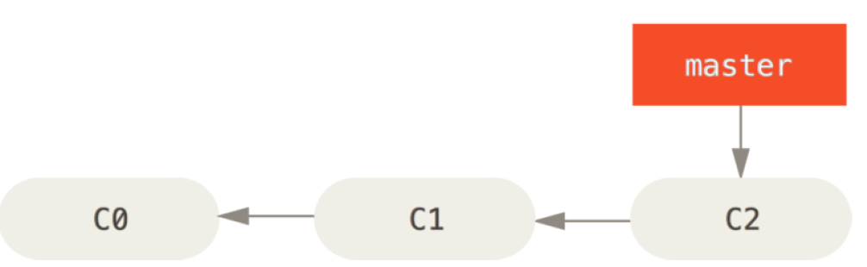
Branching
A branch in Git is simply a lightweight movable pointer to one of these commits. The default branch name in Git is master.
As you start making commits, you’re given a master branch that points to the last commit you made. Every time you commit, it moves forward automatically.

Slide 14
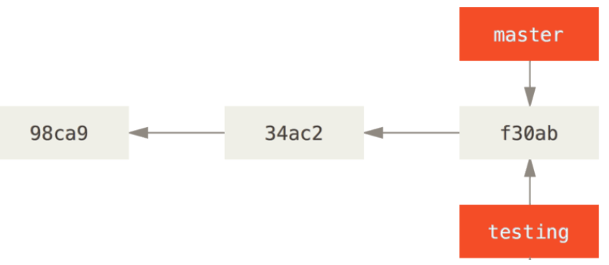
Branching
Creating a New Branch
What happens if you create a new branch? Well, doing so creates a new pointer for you to move around. Let’s say you create a new branch called testing. You do this with the git branch command:
$ git branch testing

Slide 15
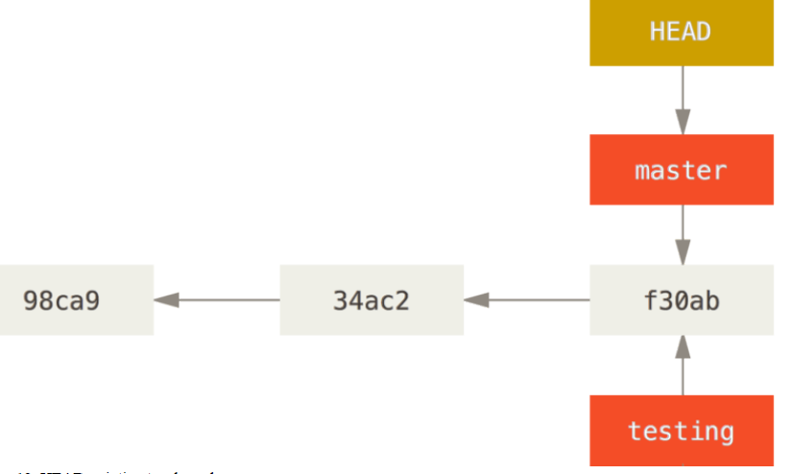
Branching
How does Git know what branch you’re currently on? It keeps a special pointer called HEAD. The git branch command only created a new branch – it didn’t switch to that branch.

Slide 16
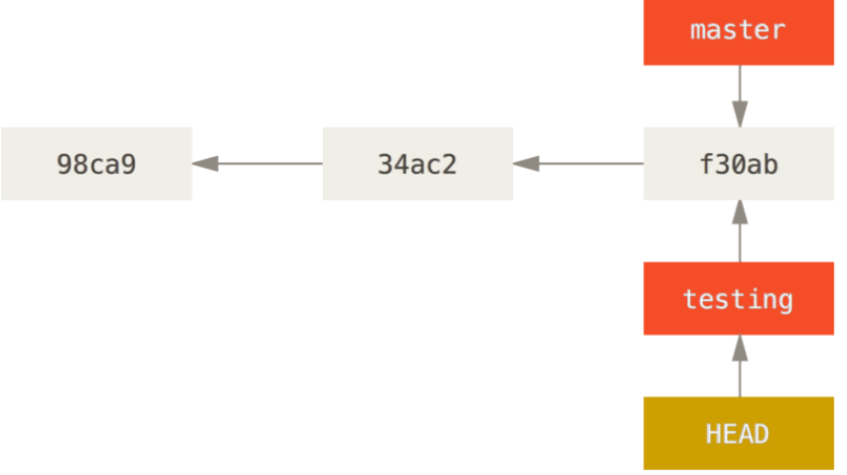
Branching
Switching Branches
To switch to an existing branch, you run the git checkout command. Let’s switch to the new testing branch:
$ git checkout testing
This moves HEAD to point to the testing branch.

Slide 17
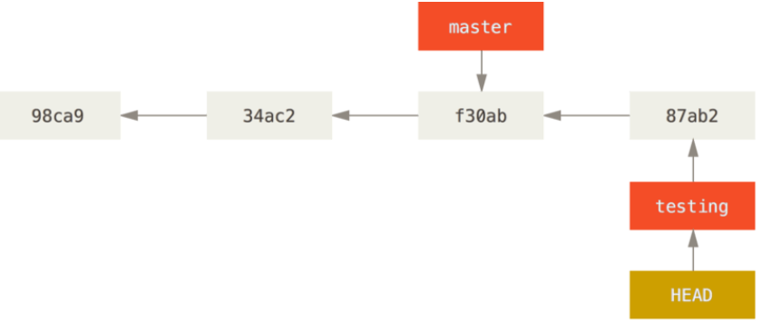
Branching
What is the significance of that? Well, let’s do another commit:
$ vim test.rb
$ git commit -a -m 'made a change'

Slide 18
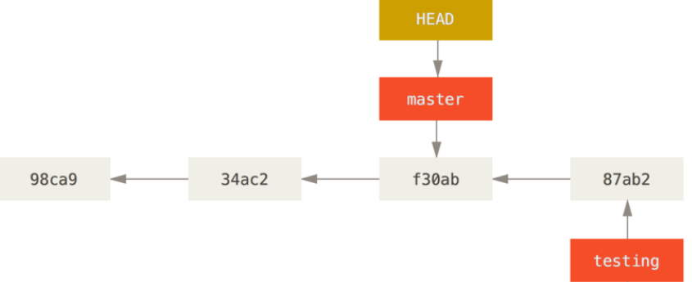
Branching
Now your testing branch has moved forward, but your master branch still points to the commit you were on when you ran git checkout to switch branches. Let’s switch back to the master branch:
$ git checkout master

Slide 19
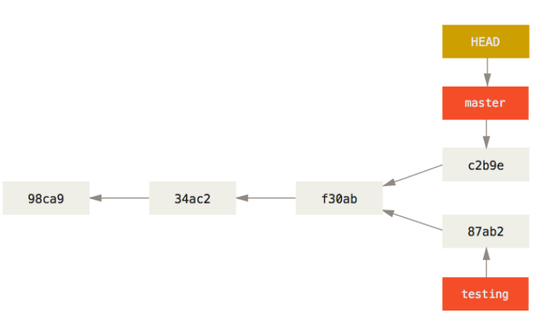
Branching
Let’s make a few changes and commit again:
$ vim test.rb
$ git commit -a -m 'made other changes‘
All changes can be viewed using git log command
$ git log

Slide 20
Branching
git merge
Integrate branches together. git merge combines the changes from one branch to another branch. For
example, merge the changes made in a staging branch into the stable branch.
Usage: # Merge changes into current branch
$ git merge <branch_name>
To delete a branch
$ git branch –d branchname
Forcefully delete:
$ git branch –D branchname

Slide 21
Working with remote
Working with remote repositories
git remote
To connect a local repository with a remote repository. A remote repository can have a name set to avoid having to remember the URL of the repository.
# Adding a remote repository with the name of beanstalk
$ git remote add origin git@account_name.git.beanstalkapp.com:/acccount_name/repository_name.git
# List named remote repositories
$ git remote -v
To connect with a remote repository :
$git remote add origin https://github.com/samplearjun/java1

Slide 22
Local to remote push
create a new repository on the command line
$ echo "# test" >> README.md
$ git init
$ git add README.md
$ git commit -m "first commit"
$ git remote add origin https://github.com/samplearjun111/test.git
$ git push -u origin master
…or push an existing repository from the command line
$ git remote add origin https://github.com/samplearjun111/test.git
$ git push -u origin master

Slide 23
Stashing
In Git, the stash operation takes your modified tracked files, stages changes, and saves them on a stack of unfinished changes that you can reapply at any time.
You want to switch branches for customer escalation, but you don’t want to commit what you’ve been working on yet; so you’ll stash the changes. To push a new stash onto your stack, run the git stash command.
$ git stash
Saved working directory and index state WIP on master: e86f062 Added my_strcpy function
HEAD is now at e86f062 Added my_strcpy function
$ git status

Slide 24
Stashing
Now, your working directory is clean and all the changes are saved on a stack. Let us verify it with the git status command.
$ git status
Now you can safely switch the branch and work elsewhere. We can view a list of stashed changes by using the git stash list command.
$ git stash list
Suppose you have resolved the customer escalation and you are back on your new feature looking for your half-done code, just execute the git stash pop command, to remove the changes from the stack and place them in the current working directory.
$ git status
$ git stash pop
$ git status

Slide 25
Git Diff
git diff - Show changes between commits, commit and working tree, etc
$ git diff (1)
1 - Changes in the working tree not yet staged for the next commit.
$ git diff --cached (2)
Changes between the index and your last commit; what you would be committing if you run "git commit" without "-a" option.
$ git diff HEAD (3)
Changes in the working tree since your last commit; what you would be committing if you run "git commit -a"

Slide 26
Git Diff
$ git diff HEAD^ HEAD
Compare the version before the last commit and the last commit.
$ git diff test
Instead of using the tip of the current branch, compare with the tip of "test" branch.
$ git diff topic master
Changes between the tips of the topic and the master branches.

Slide 27
Remove from staging
git rm
Remove files or directories from the working index (staging area). With git rm, there are two options to keep in mind: force and cached. Running the command with force deletes the file. The cached command removes the file from the working index. When removing an entire directory, a recursive command is necessary.
Example:
# To remove a file from the working index:
$ git rm --cached css/style.css
rm 'css/style.css'
# To delete a file (force):
$ git rm -f css/style.css
rm 'css/style.css'

Slide 28
Undoing Things
One of the common undos takes place when you commit too early and possibly forget to add some files, or you mess up your commit message. If you want to redo that commit, make the additional changes you forgot, stage them, and commit again using the --amend option:
$ git commit --amend

Slide 29
Unstaging a Staged File
Git Reset
Step 1: Move HEAD
The first thing reset will do is move what HEAD points to. This isn’t the same as changing HEAD itself (which is what checkout does); reset moves the branch that HEAD is pointing to. This means if HEAD is set to the master branch (i.e. you’re currently on the master branch), running git reset 9e5e6a4 will start by making master point to 9e5e6a4.
git reset HEAD CONTRIBUTING.md
Unmodifying a Modified File
git checkout -- CONTRIBUTING.md

Slide 30
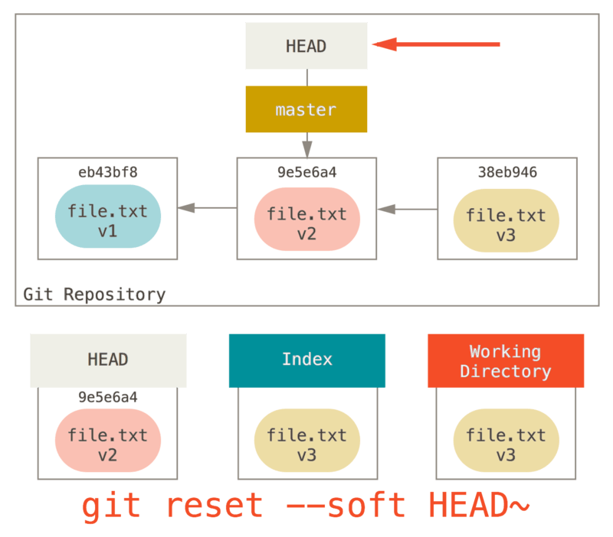
Git Reset

